Slide 1
SyRIALtEL CUSTOMER CHURN
PHASE 3 PROJECT

Slide 2
INtroduction
SyrialTel wants to predict customer churn and estimate financial losses.
Churn affects revenue hence predicting it helps in retention strategies.

Slide 3
Business understanding
Churn is when customers stops doing business with a company over a given period of time.
The thing that can make the customers to leave is poor service, long contracts and pricing issues.
The Objective is to churn and improve customer retention.

Slide 4
Data preprocessing
The dataset used is BIGML dataset
Steps taken:
Handling missing values
Data cleaning

Slide 5
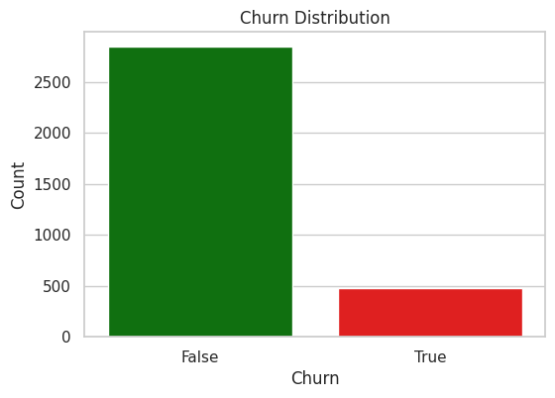
Data Analysis
Churn Distribution
Show imbalance in the dataset.

Slide 6
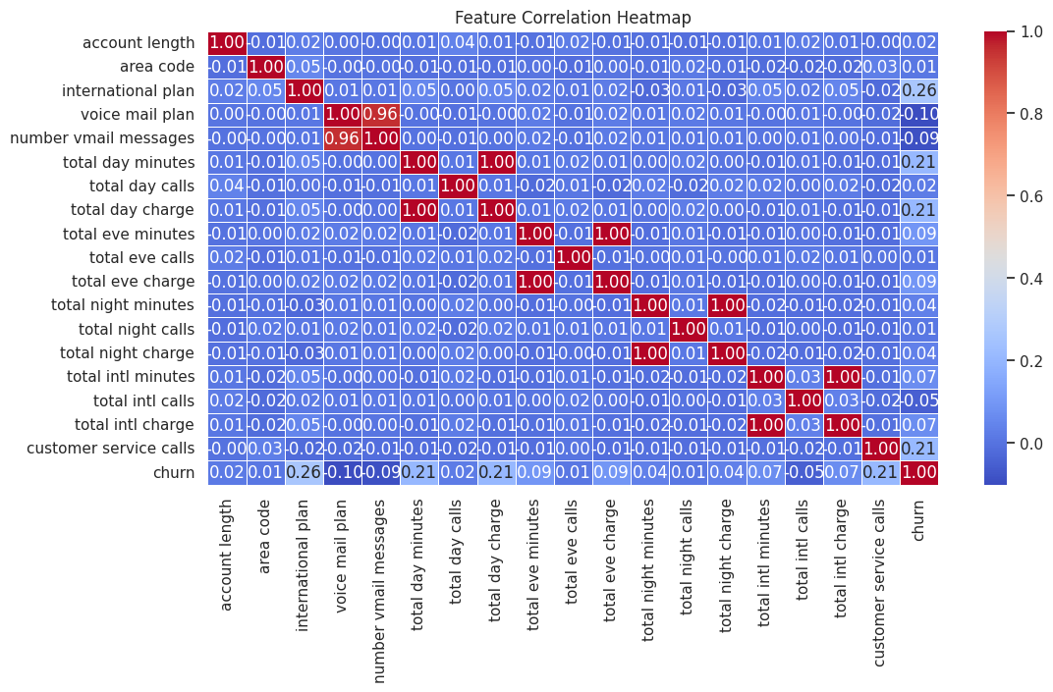
Data analysis
Correlation Heatmap
Customer service calls churned

Slide 7
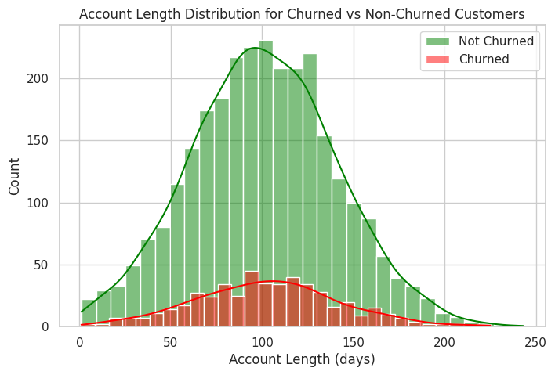
Data analysis
Account length vs churn
Longer accounts also churn

Slide 8
Model and performance
Models Tested: Logistic regression, Decision Tree and K-NN
Best Model: Random Tree with 94% accuracy and 96% precision.
Key Metric: Recall = 74% detects most churners.
 | Accuracy | Recall | F1-Score | Precision | Pros | Cons
Logistic Regression | 85% | 74% | 19% | 52% | Simple interpretable. | Low f1 meaning the model is not balancing
Random Forest | 94% | 74% | 76% | 96% | Easy to intepret | Prone to overfitting
SVM | 85% | 74% | 23% | 93% | simple | Imbalanced model
Decision Tree | 92% | 74% | 74% | 74% | Easy to interpret | Prone to overfitting
K-NN | 86% | 74% | 34% | 59% | simple | Model is not balancing

Slide 9
recommendation
Improve customer support
Engage Customers Proactively
Handle class imbalance.
Boost model Recall to 80-90%.

Slide 10
cONCLUSION
Customer service calls are a strong churn indicator.
Random Tree is the best model.
Better support and engagement can reduce churn.
Next Steps: Implement retention strategies and Improve predictions.

